Slide 1
Agenda
Creational Design Patterns
What is GOF?
GOF Design Patterns
Commonly Used Patterns
Creational Design Patterns
Singleton
Prototype
Factory Method
Abstract Factory
Builder

Slide 2
What is Multi Threading?
Code Segment
Stack Segment
Data Segment
static - shared – not thread safe
Class Account{
Private static BigDecimal currentBalance;
Private BigDecimal outstandingBalance; // thread safe or not thread safe???
}
C
C
C
S
S
S
Static
Singleton
Not thread safe
D

Slide 3
How the enclosing class looks like
User{
Account a1;
//singleton}
Class - Account
Class Account{
Private static BigDecimal currentBalance;
Private BigDecimal outstandingBalance; // thread safe or not thread safe???
}
A1
outstandingBalance (not thread safe)
Class - User

Slide 4
C
C
C
S
S
S
D
D
D

Slide 5
What is GOF?
In 1994, four authors Erich Gamma, Richard Helm, Ralph Johnson and John Vlissides published a book (Design Patterns: Elements of Reusable Object-Oriented Software) for explaining the concept of Design Patterns in Software development.
These four authors are collectively known as Gang of Four (GOF).
The 23 Design patterns are defined by the GOF programmers which are divided into three groups depending on the nature of the design problem they intend to solve.
Notes:
SOLID principles form the fundamental guidelines for building object-oriented applications.

Slide 6
GOF Design Patterns
GOF Design Patterns
Creational Design Patterns
Structural Design Patterns
Behavioural Design Patterns
Deals with the process of objects creation
Deals with the composition of objects structures
Deals with the process of communication, relationships and responsibilities between objects

Slide 7
Commonly Used GOF Design Patterns
Creational Patterns
Singleton
Factory
Abstract Factory
Builder
Structural Patterns
Adapter
Bridge
Façade
Proxy
Behavioral Patterns
Command
Iterator
State
Strategy

Slide 8
Commonly Used GOF Design Patterns
Class.
But instance should not be created. How to achieve?
Private constructor

Slide 9
Creational Design Patterns
Deals with the process of objects creation in such a way that they can be decoupled from their implementing system.
Provides more flexibility in deciding which object need to be created for a given use case or scenario.
There are 5 design patterns in this category which are:
  Singleton
  Prototype
  Factory Method
  Abstract Factory
  Builder

Slide 10
Creational Design Patterns

Slide 11
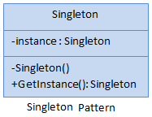
Singleton Pattern
Ensures that a class has only one instance and provides a global point of access to it.
Singleton class includes:
  Static private Instance
  Private Constructor
  Public Instance Property or GetInstance() method
Notes:
Static classes are not for anything that needs state. Useful for putting a set of functions together i.e Math (or Utils in projects).
Singleton can maintain its state and implement interfaces inherited from other classes but the static class does not.
A Singleton can be initialized lazily or asynchronously and loaded automatically.
A static class allows only static methods but in Singleton you can have non static method as well.
Singleton Objects stored on heap while static class stored in stack.
Singleton Objects can have constructor while Static Class cannot.
Singleton Objects can dispose but not static class.
Singleton Objects can clone but not with static class.
A static class is one that has only static methods, for which a better word would be "functions". The design style embodied in a static class is purely procedural.
Singleton, on the other hand, is a pattern specific to OO design.

Slide 12
Singleton Pattern Examples
Need a single instance of an object throughout the application
  Exception Logging
  Global Configuration Object
  Database Manager
  Business Layer Manager

Slide 13
Static Class vs. Singleton Pattern
Members (fields, properties, methods) must be static.
Cannot implement interfaces directly since instance is not created.
Less flexibility in terms of object-oriented design principles.
Use static initialization and use immutable data to make it thread-safe. For Mutable data use lock.
Usecase: When you need a collection of utilities or constants and access directly using the class name.
Members (fields, properties, methods) can be static and non-static.
Can implement interfaces and be subclassed. So flexible compared to static.
The single instance is created lazily when it is needed for the first time.
Use lazy initialization with double check locking or Lazy<T> type for thread safe initialization.
Usecase: When you need to maintain state and there should be exactly one instance of the class accessible globally.
Notes:
A static class can maintain state, but it should not generally be used to manage mutable shared state unless absolutely necessary.

Slide 14
DEMO
Singleton Pattern Example

Slide 15
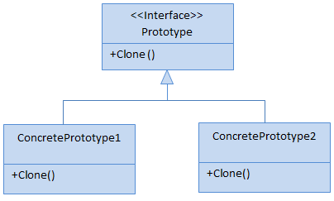
Prototype Pattern
Used to create a duplicate object or clone of the current object to enhance performance.
Used when creation of an object is costly or complex.

Slide 16
Prototype Pattern Examples
App needs copies of objects, where objects
  Are not simple value types.
  Have other objects as properties like Customer has Address object property

Slide 17
Shallow Copy
Only top-level objects are duplicated or copied. Shallow copy creates a new object by copying the non-static fields of the current object to the new object.
If a field is value type then a bit-by-bit copy of the field is performed.
If a field is reference type then the reference is copied but the referred object is not. Hence the original object and its clone refer to the same object.

Slide 18
Deep Copy
All objects are duplicated or copied.
Deep copy creates a new object by copying the non-static fields of the current object to the new object.
If a field is value type then a bit-by-bit copy of the field is performed.
If a field is reference type then a new copy of the referred object is performed.

Slide 19
Class User{
BigDecimal a1;
int a2;
String a3;
StringBuilder a4;
ArrayList a5;
Account a6;
}

Slide 20
Class Department{
String name;
int id;
//400 attributes
}
//I want to create 20 instances of Department. But, the 19 instances needs just name change. Remaining attributes are same.
Departmen d1 = new Department();
d2 = d1.clone();
D20;

Slide 21
DEMO
Prototype Pattern Example

Slide 22
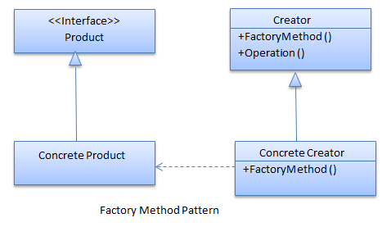
Factory Method
Allow us to create object without exposing the creation logic.
An interface is used for creating an object, but subclass decide which class to instantiate.

Slide 23
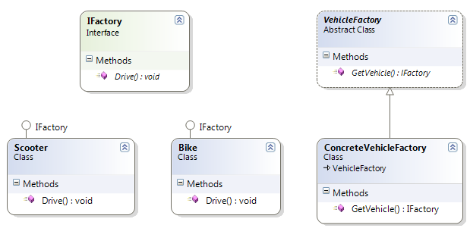
Factory Method Real Life Example

Slide 24
Factory Method Examples
Need to create different logger types
  Console Logger
  Database Logger
  File Logger etc.
Need to create different report types
  PDF
  Word etc.

Slide 25
DEMO
Factory Method Example

Slide 26
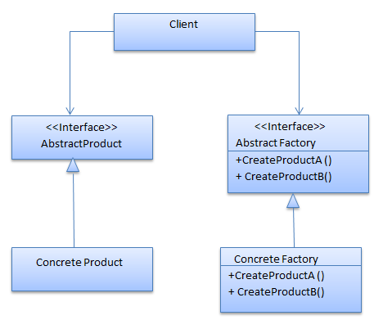
Abstract Factory
Acts a super-factory which creates other factories. This pattern is also called as Factory of factories.
In Abstract Factory pattern an interface is responsible for creating a factory of related objects, or dependent objects without specifying their concrete classes.

Slide 27
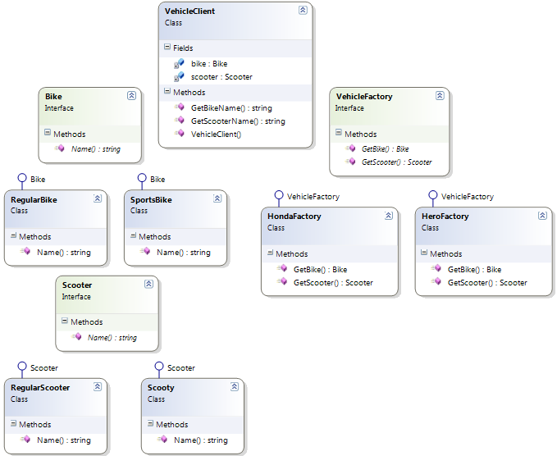
Abstract Factory Real Life Example

Slide 28
Abstract Factory Examples
Need to support multiple database types
  SQL Server
  Oracle
  MySQL etc.
Need to support multiple office types
  MS Office
  Google Docs
  OpenOffice etc.

Slide 29
Abstract Factory Examples
Java Swing
Java AWT/SWT.
GUIFactory{
  //SwingFactory
  //SWTFactory
  //AWTFactory
}

Slide 30
DEMO
Abstract Factory Example

Slide 31
Factory Pattern vs. Abstract Factory Pattern
Use inheritance and relies on concrete class to create object.
Produce only one product.
Hides the creation process of single object
Factory may use Singleton design pattern for creating objects.
Use composition to delegate object creation responsibility to another class
Produce a family of related products
Hides the creation process of a family of related objects
Abstract Factory may use Factory pattern or Builder design pattern or prototype design pattern for creating objects.
Notes:
let’s intuitively define composition as when the class uses another object to provide some or all of its functionality.

Slide 32
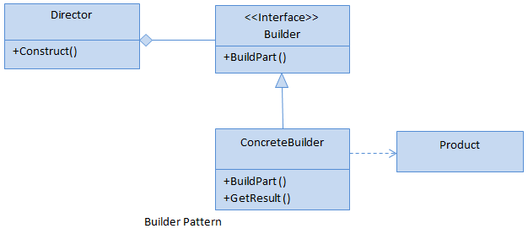
Builder Pattern
Used to build a complex object by using a step-by-step approach.
Builder interface defines the steps to build the final object.
A class that is known as Director, controls the object creation process.
Describes a way to separate an object from its construction. The same construction method can create a different representation of the object.
Notes:
This builder is independent from the objects creation process.

Slide 33
Builder Pattern
Create Engine
Create Window
Create Steering
Create Wheel
Create Gearbox
Create smaller smaller features and then finally assemble them to concrete class.
Notes:
This builder is independent from the objects creation process.

Slide 34
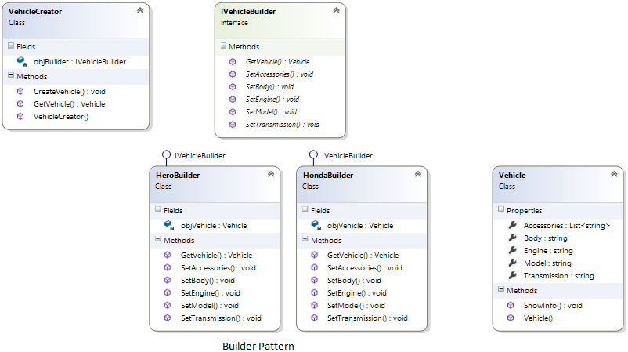
Builder Pattern Real Life Example

Slide 35
Builder Pattern Examples
Construct Report/Email Builder Class
  Set Header
  Set Body
  Set Footer

Slide 36
DEMO
Builder Pattern Example

Slide 37
Abstract Factory Pattern vs. Builder Pattern
Provides an interface to create families of related objects without specifying their concrete classes.
Returns instances directly from factory methods.
Does not keep the track of its created Object.
Abstract Factory may use Builder design pattern for creating objects.
This pattern creates a complex object in several steps.
Constructs objects incrementally through multiple steps.
Keeps the reference of its created Object.
Doesn’t rely on Abstract Factory pattern.
Notes:
let’s intuitively define composition as when the class uses another object to provide some or all of its functionality.

